Slide 1
Convolutional Neural Networks (CNN) Part 3
D E P A R T M E N T O F C O M P U T E R S C I E N C E U N I V E R S I T Y O F C O P E N H A G E N
Søren Olsen

Slide 2
Popular CNN-modules
Image classification, Object detection and Segmentation
Loss functions
AlexNet
VGG11-16-19
ResNet
Feture Pyramid Networks (FPN)
R-CNN-family, Unet
Course Evaluation

Slide 3
Loss functions
The loss function determines the performance!
For regression use the sum of squared errors. This is a maximum likelihood estimate if the error is normally distributed.
For classification use cross-entropy error and one hot encoding if multiple classes. Often, a soft-max activation function is applied to make the output integrate to 1.0.
When bounding boxes and/or masks are to be estimated simultaneously, the loss function will be a composition.

Slide 4
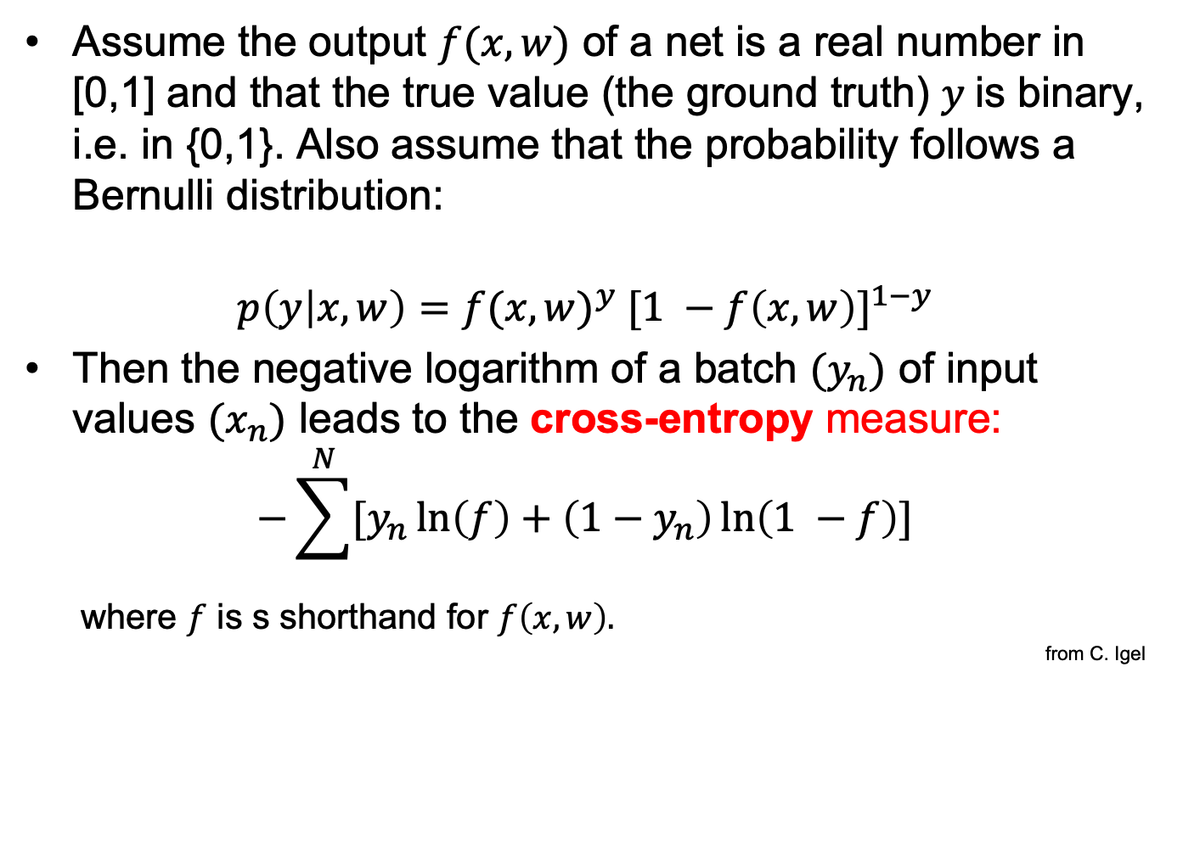
Loss function for binary classification
Assume the output $f(x,w)$ of a net is a real number in [0,1] and that the true value (the ground truth) $y$is binary, i.e. in {0,1}. Also assume that the probability follows a Bernulli distribution:
$$p\left(y | x,w\right)={f(x,w)}^{y} {[1 −f\left(x,w\right)]}^{1−y}$$
Then the negative logarithm of a batch $(y_{n})$ of input values $(x_{n})$ leads to the cross-entropy measure:
$$−\sum^{N}{[y_{n}\ln\left(f\right)+\left(1−y_{n}\right)\ln\left(1 −f\right)]}$$
where $f$ is s shorthand for $f\left(x,w\right).$
from C. Igel

Slide 5
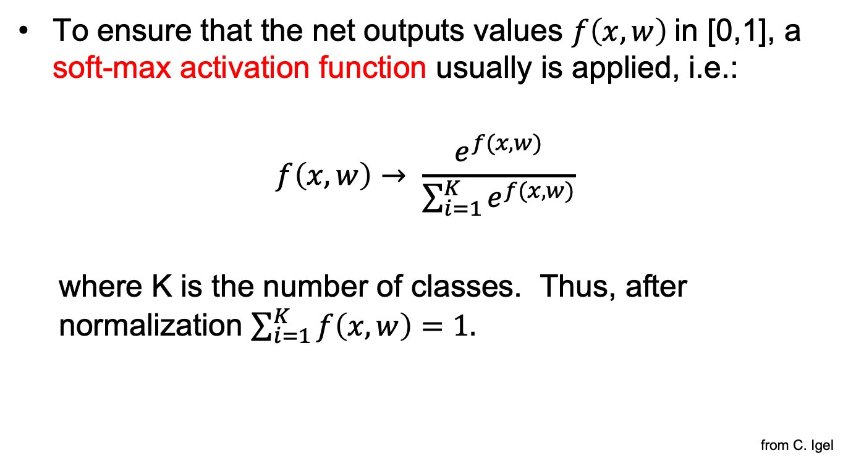
Soft-max
To ensure that the net outputs values $f\left(x,w\right)$in [0,1], a soft-max activation function usually is applied, i.e.:
$$f\left(x,w\right)→ \frac{e^{f(x,w)}}{\sum_{i=1}^{K}{e^{f(x,w)}}}$$
where K is the number of classes. Thus, after normalization $\sum_{i=1}^{K}{f\left(x,w\right)=1.}$
from C. Igel

Slide 6
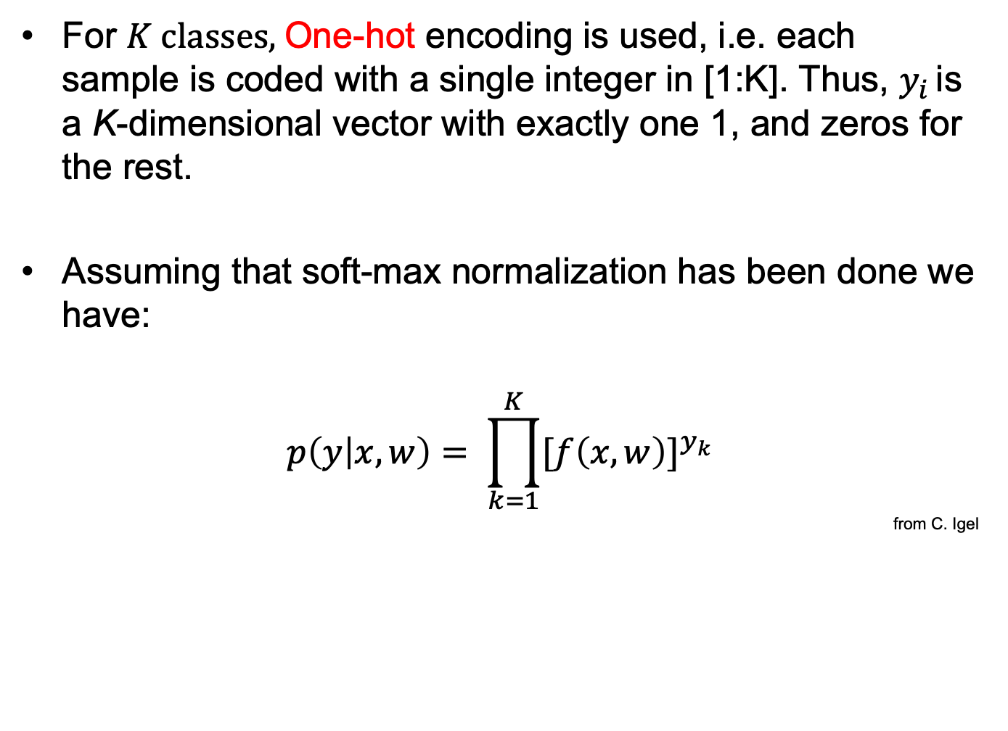
Multi class classification
For $K classes,$One-hot encoding is used, i.e. each sample is coded with a single integer in [1:K]. Thus, $y_{i }$is a K-dimensional vector with exactly one 1, and zeros for the rest.
Assuming that soft-max normalization has been done we have:
$$p\left(y | x,w\right)= \prod_{k=1}^{K}{{[f\left(x,w\right)]}^{y_{k}}}$$
from C. Igel

Slide 7
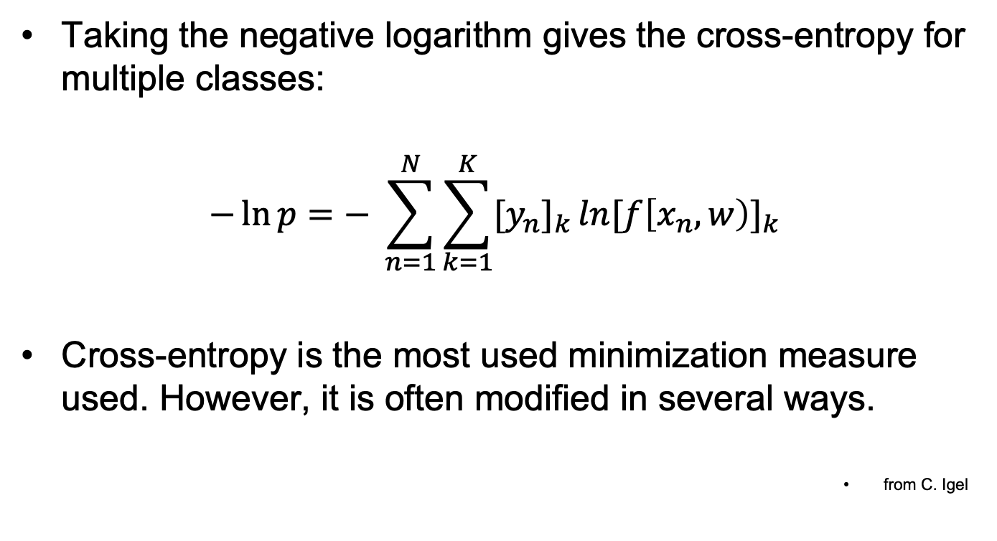
and further
Taking the negative logarithm gives the cross-entropy for multiple classes:
$$−\ln{p}=− \sum_{n=1}^{N}{\sum_{k=1}^{K}{{[y_{n}]}_{k }ln{[f\left[x_{n},w\right)]}_{k}}}$$
Cross-entropy is the most used minimization measure used. However, it is often modified in several ways.
from C. Igel

Slide 8
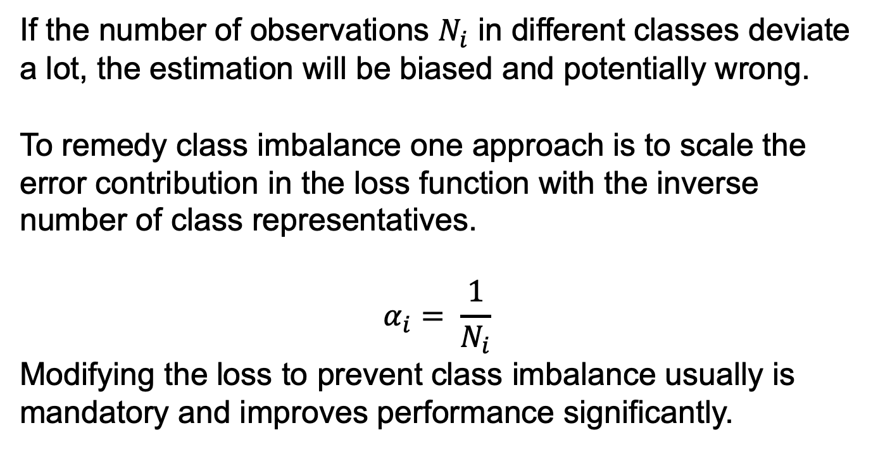
Class imbalance
If the number of observations $N_{i}$ in different classes deviate a lot, the estimation will be biased and potentially wrong.
To remedy class imbalance one approach is to scale the error contribution in the loss function with the inverse number of class representatives.
$$α_{i}= \frac{1}{N_{i}}$$
Modifying the loss to prevent class imbalance usually is mandatory and improves performance significantly.

Slide 9
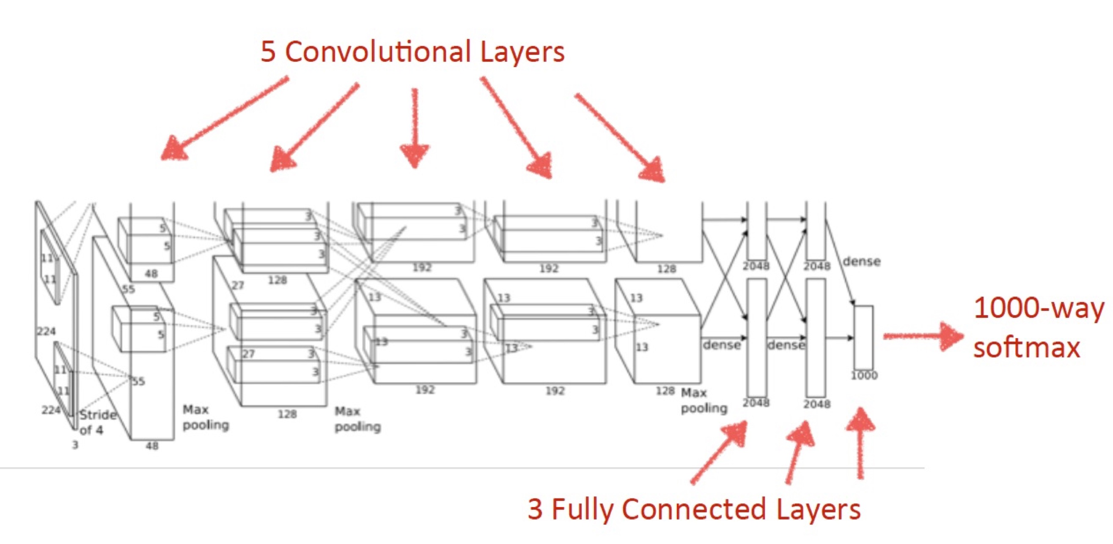
AlexNet

Slide 10
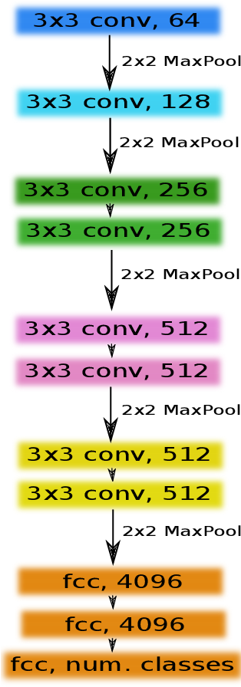
VGG family – VGG11

Slide 11

VGG-family VGG-16

Slide 12
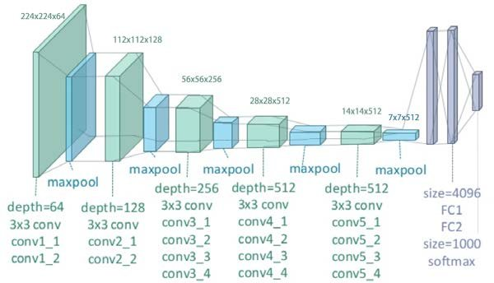
VGG-family VGG19

Slide 13
Vanishing gradient problem
Researchers found that for shallow nets, increasing the number of layers improved performance. For deeper nets, the performance decreased. The feature abstraction change will be slower.
The immediate consequence is that the training gradient becomes smaller between neighboring layers and tend to vanish.
In He, Zhang, Ren, Sun: Deep Residual Learning for Image Recognition a new Residual learning building block is proposed and shown to solve the vanishing gradient problem.

Slide 14
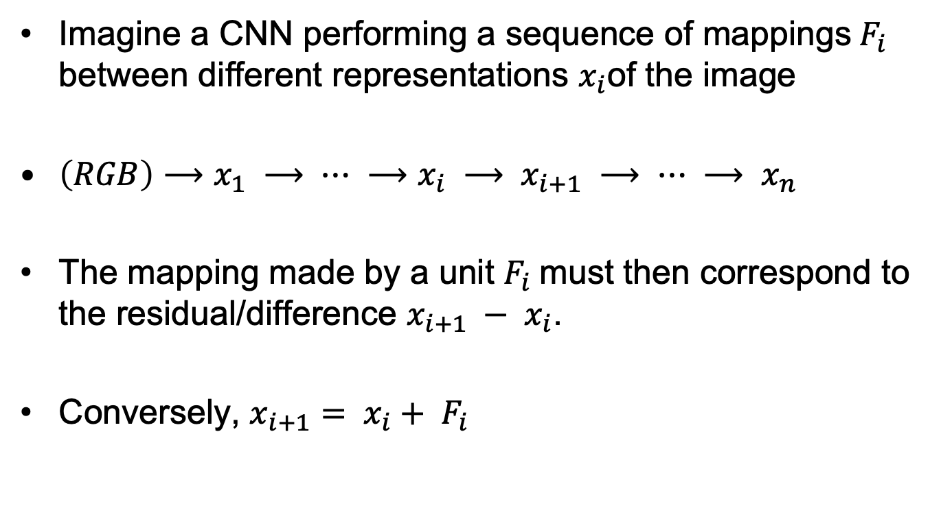
Residual building bloak
Imagine a CNN performing a sequence of mappings${ F}_{i}$ between different representations $x_{i}$of the image
$\left(RGB\right)⟶x_{1} ⟶ ⋯ ⟶x_{i} ⟶ x_{i+1} ⟶ ⋯ ⟶ x_{n}$
The mapping made by a unit $F_{i}$must then correspond to the residual/difference $x_{i+1} − x_{i}$.
Conversely, $x_{i+1}= x_{i}+ F_{i}$

Slide 15
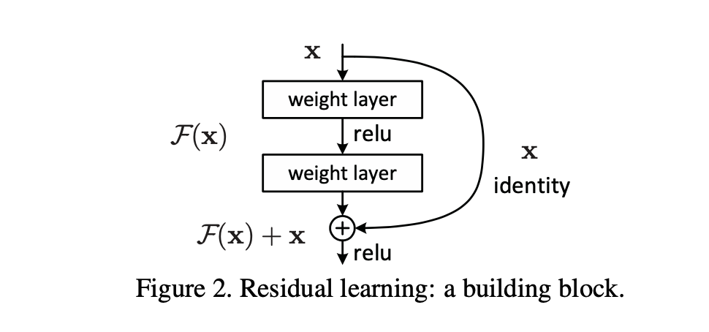
Residual building block
The residual building block is used in ResNet50, ResNet101 and
ResNet152 (reference networks) and is shown to work for a net with
1202 layers.
For very deep structures also, the Bottleneck building block is popular.

Slide 16
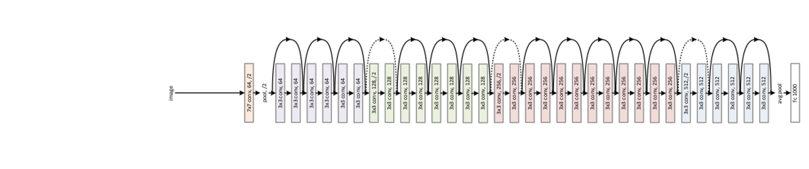
ResNet: ResNet34 (skipping, 18, 50, 101, 152, 1202)
Today, ResNet50, ResNet101 and Resnet152 serve as common backbone-net
in many applications.

Slide 17
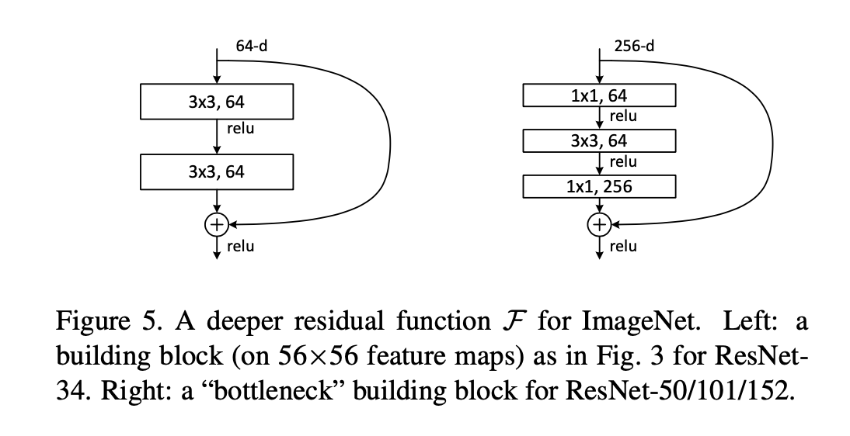
The Bottleneck building block
The bottleneck idea is to downscale the channel number before convolution
and upscale again after convolution. Here combined in a residual context.

Slide 18
Questions ?

Slide 19
Many other CNN constructions
We will skip a lot of contributions, including
Inception Net family
Squeeze and Exitation Net
DenseNet
R-FCN
DeepNet
Efficent Net
Yolo, SSD
R-CNN family
etc.
Instead, I will sketch a single semantic segmentation method.

Slide 20
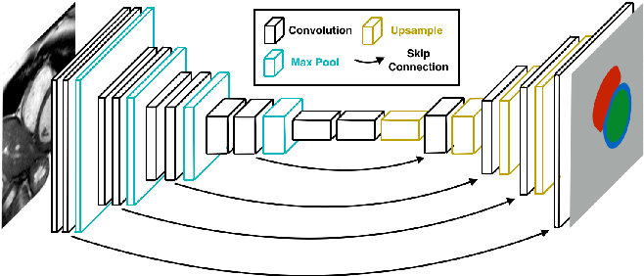
Skip connections
Skip connections may be done as in residual building blocks but may also span a larger range. In e.g. UNet information from the first levels is carried through
The combination of skip connections and upsampling (e.g. for use in
semantic segmentation) may be seen as an alternative to use of a
feature pyramid.

Slide 21
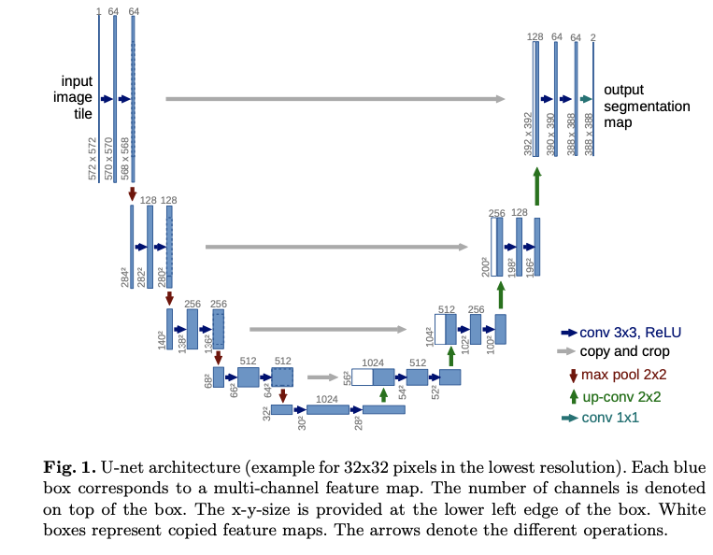
UNet

Slide 22
Examples
The next slides how a few examples by YOLO, HTC and Mask R-CNN on object detection, classification and instance segmentation.

Slide 23
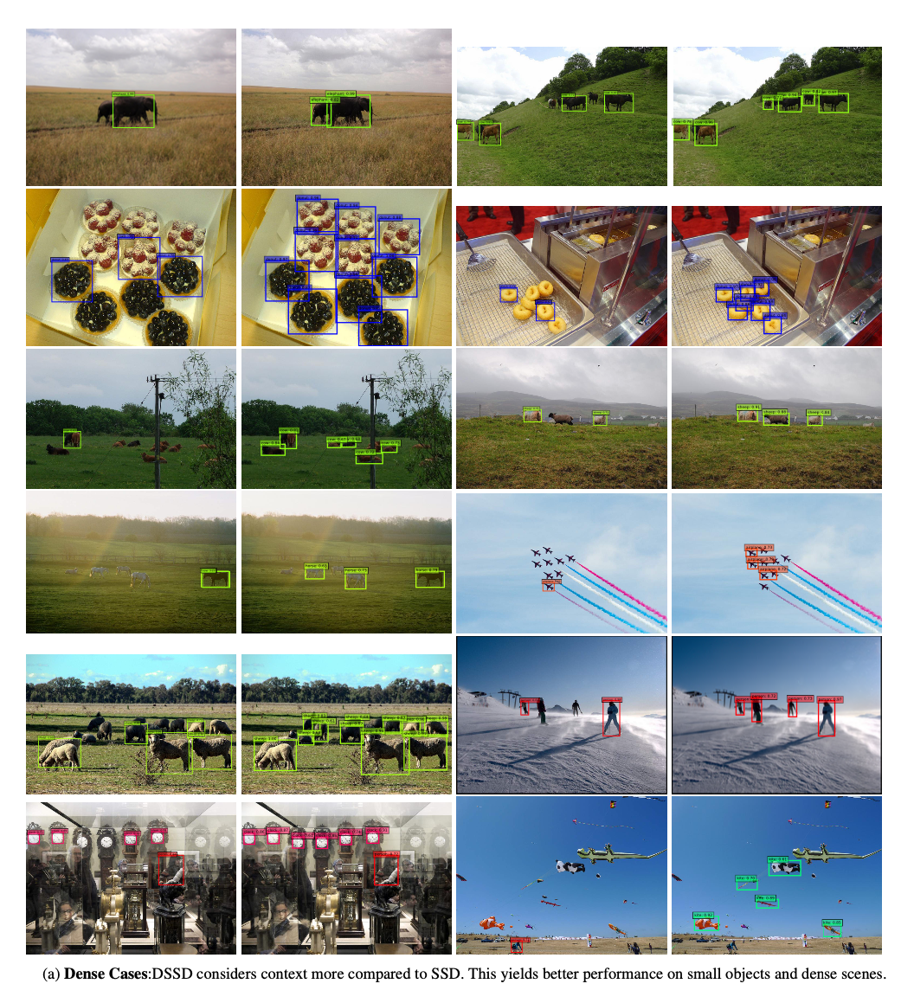

Slide 24
You Only Look Once (YOLO)
Redmon et al, 2016
In the paper, cell grid is 7 x 7 with B=2 bounding boxes per cell.
Therefore YOLO can only detect up to 98 objects in an image.
Notes:
But only 49 different object types.

Slide 25
YOLO: Examples of results
Redmon et al, 2016
Notes:
Second row, second image from left – the guy flying is misclassified as an aeroplane.

Slide 26
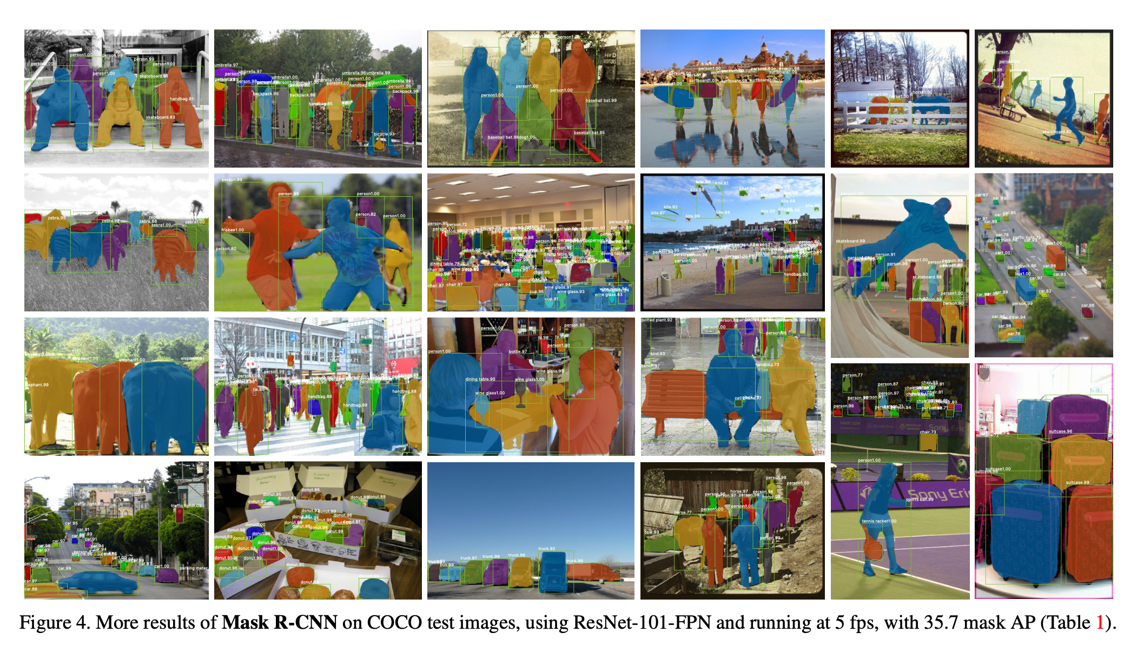
mask R-CNN results

Slide 27
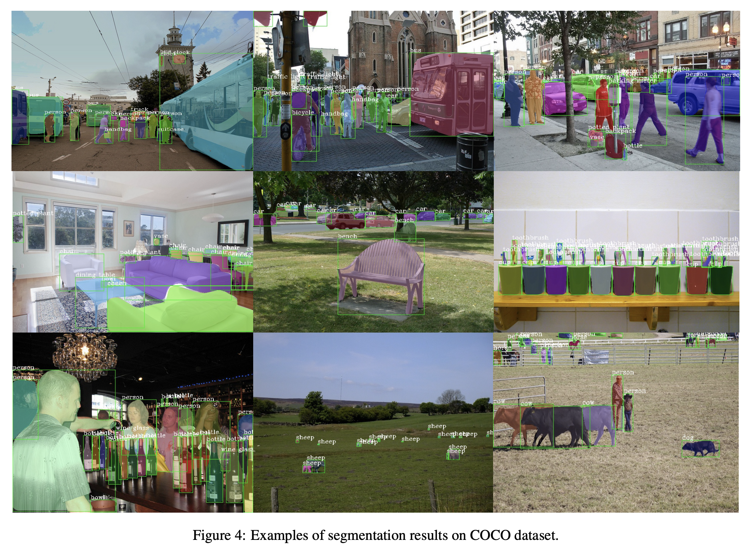
HTC results on COCO

Slide 28
NO MORE CNN
Questions (almost last chance)

Slide 29
Results from Evaluation
You think you work too hard, but you have just used the allocated time.
You are satisfied with the feedback and help from the TA’s.
You would prefer that all lectures were recorded, but you are split wrt. the benefits of online teaching.
You find the teaching material relevant, the academic level appropriate, and the course outcome useful.

Slide 30
Do you have any comments, further suggestions etc. before we close ?

Slide 31
Farewell
We hope that you will be able to use the techniques that we have been through.
Best wishes for your future study and life
Francois and Søren,
Navid, Steffen, Peidi

